Slide 1
Lecture-4 aquifer influx models
Pot aquifer
Schilthuis’ steady-state
Hurst’s modified steady-state
The van Everdingen-Hurst unsteady-state
Edge-water drive
Bottom-water drive
Linear-water drive
The Carter-Tracy unsteady-state
Fetkovich’s method
Radial aquifer
Linear aquifer

Slide 2
Fetkovich’s Method

Slide 3
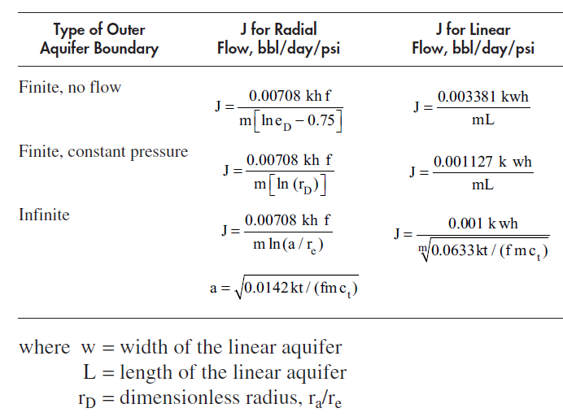
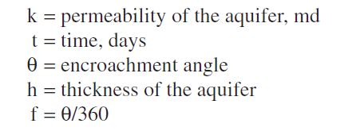
m is the viscosity

Slide 4
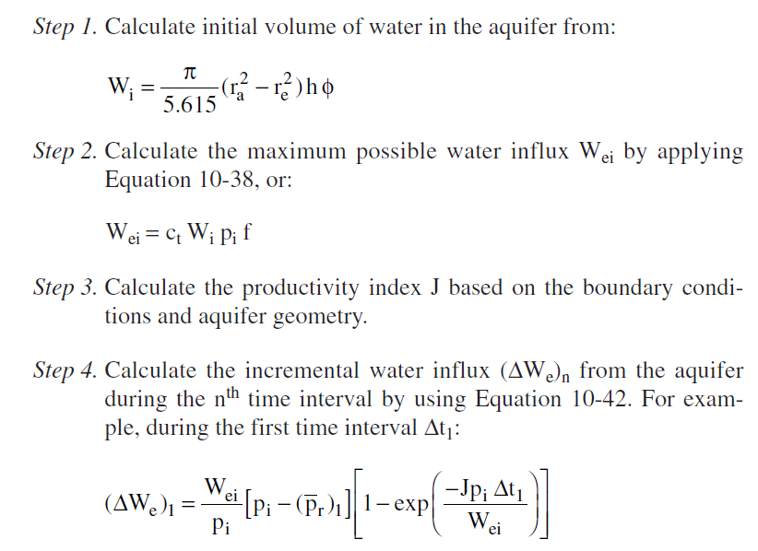
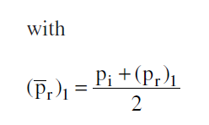

Slide 6
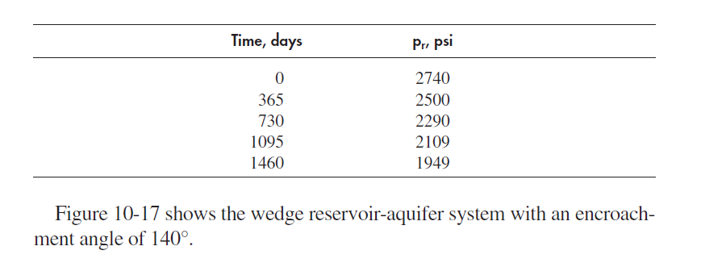

Slide 7
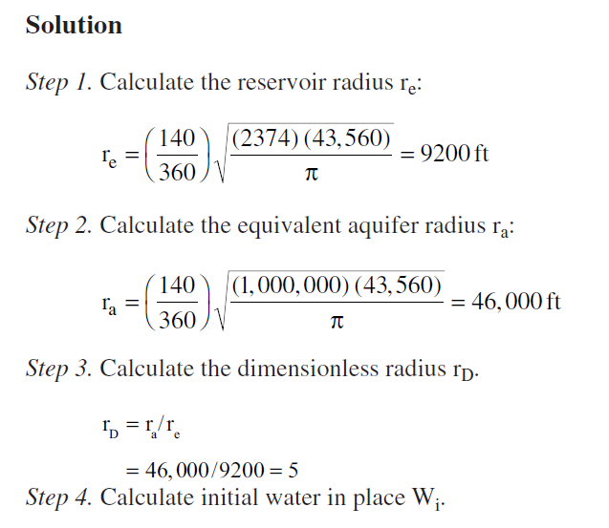

Slide 8
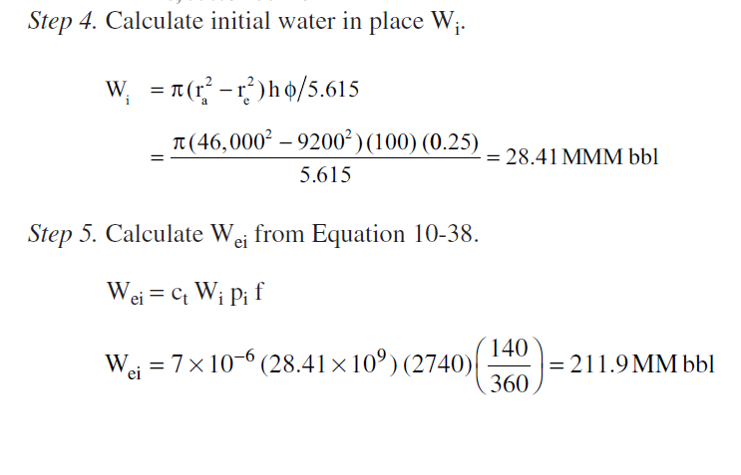

Slide 9
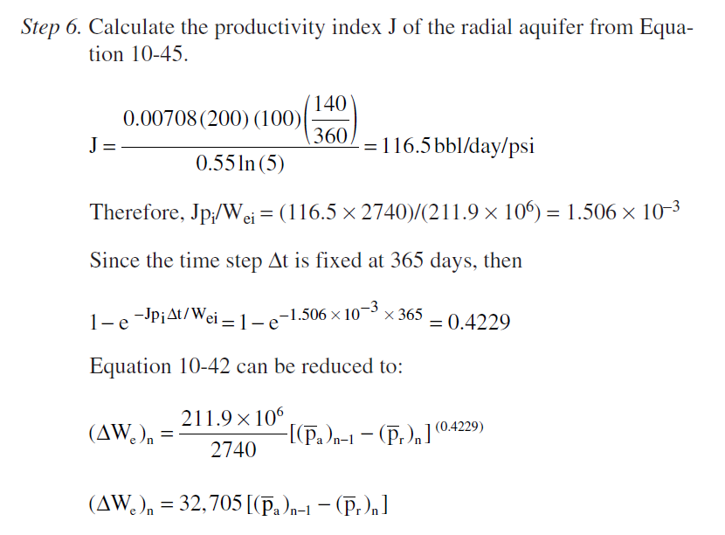
Be careful there is a mistake to calculate J in the book
( -0.75)

Slide 10
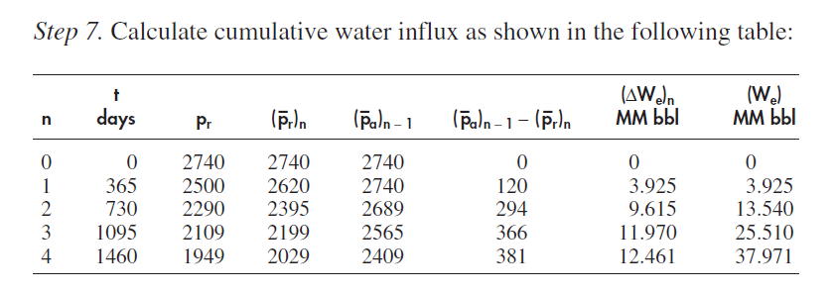

Slide 12
See you next time inshallah
HAVE A NICE TIME

